Slide 1
Odoo Tutorial
Development Environment Setup
New Application
Models
Security - A Brief Introduction
Views
Controllers

Slide 2
Development Environment Setup
Github
Clone git source code
$ mkdir -p $HOME/src
$ cd $HOME/src
$ git clone git@github.com:odoo/odoo.git
Checkout git branch version
$ git checkout 14.0
Install pip3 and libraries
$ sudo apt install python3-pip python3-dev libxml2-dev libxslt1-dev libldap2-dev libsasl2-dev libssl-dev libpq-dev libjpeg-dev
Install odoo requirements
$ cd $HOME/src/odoo
$ pip3 install -r requirements.txt
Install PostgreSQL
$ sudo apt install postgresql postgresql-client
$ sudo -u postgres createuser -s $USER
Run the server odoo-bin command
$ odoo/odoo-bin --addons-path=./custom,./odoo/addons -r <db_username> -w <db_password> -d <db_name> -u <module> --dev xml
--addons-path: directory của modules
--d: database name
-r: database username
-w: database password
-u: update for module
--dev xml: develop xml mode - không phải restart server khi edit view

Slide 3
Development Environment Setup
Install Odoo via Docker
Install docker: https://docs.docker.com/engine/install/ubuntu/
Install docker compose: https://docs.docker.com/compose/install/
Install Odoo
https://hub.docker.com/_/odoo

Slide 4
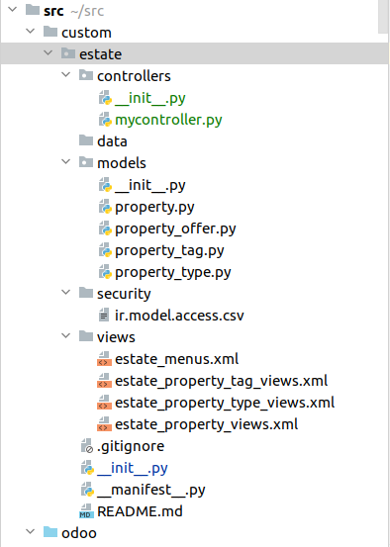
New Application
Prepare addon directory
Create custom directory
$ mkdir /home/$USER/src/custom
Tạo thư mục custom, nơi lưu các custom modules
Create module directory
$ mkdir /home/$USER/src/custom/estate
$ cd /home/$USER/src/custom/estate
$ touch __init__.py
$ touch __manifest__.py
Tạo estate module trong thư mục custom
Một module bắt buộc phải gồm 2 file __init__.py và __manifest__.py

Slide 5
Models
Estate model
estate/models/property.py
class PropertyModel(models.Model):
_name = 'estate.property'
_description = 'Property Description'
_order = 'id desc'
name = fields.Char()
description = fields.Text()
estate/models/__init__.py
from . import property
estate/__init__.py
from . import models
Definition
class extend từ models.Model
_name: Bắt buộc. Dấu “ . “ trong giá trị được ORM chuyển thành “_” và lưu thành database table name
Basic Fields
Các basic fields: fields.Char, fields.Integer..
Ref: https://www.odoo.com/documentation/14.0/developer/reference/addons/orm.html#basic-fields
Các fields sẽ được apply vào database khi chạy -u <module_name>. Vdu: -u estate

Slide 6
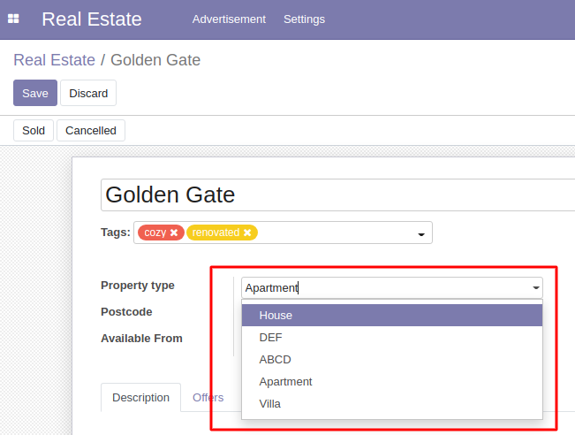
Models
Many2one relation
estate/models/property_type.py
class PropertyTypeModel(models.Model):
_name = 'estate.property.type'
_description = 'Property type description'
name = fields.Char()
estate/models/property.py
class PropertyModel(models.Model):
_name = 'estate.property'
_description = 'Property Description'
name = fields.Char()
description = fields.Text()
property_type_id = fields.Many2one('estate.property.type', string='Property type', ondelete='set null')

Slide 7
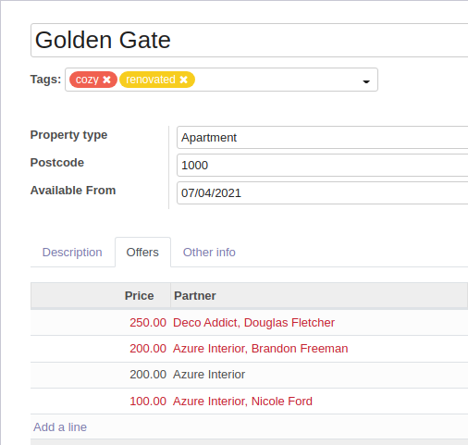
Models
One2many relation
One2many is a virtual relationship, there must be a Many2one field defined in the comodel.
Support for inline view
estate/models/property_order.py
class PropertyOfferModel(models.Model):
_name = 'estate.property.offer'
price = fields.Float()
property_id = fields.Many2one('estate.property', string='Property')
estate/models/property.py
class PropertyModel(models.Model):
. . .
offer_ids = fields.One2many('estate.property.offer', 'property_id', string='Offers')

Slide 8
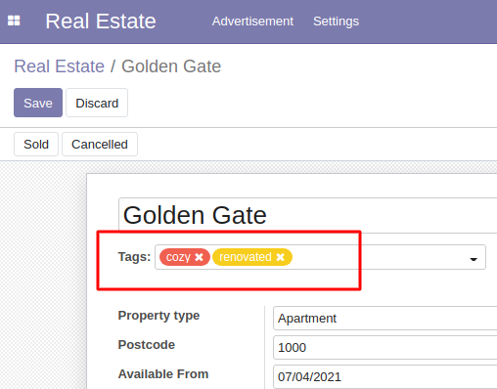
Models
Many2many relation
One2many is a virtual relationship, there must be a Many2one field defined in the comodel.
Support for inline view
estate/models/property_tag.py
class PropertyTagModel(models.Model):
_name = 'estate.property.tag'
name = fields.Char()
color = fields.Integer(default=0)
estate/models/property.py
class PropertyModel(models.Model):
. . .
property_tag_ids = fields.Many2many('estate.property.tag', string='Property tags')

Slide 9
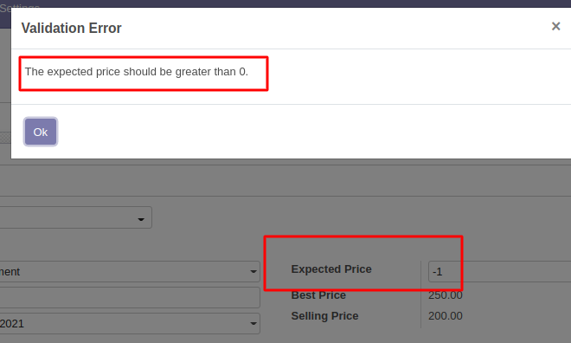
Models
Constraints - Validation
SQL constraints
estate/models/property.py
class PropertyModel(models.Model):
. . .
_sql_constraints = [
('check_positive_expected_price', 'CHECK(expected_price >= 0)',
'The expected price should be greater than 0.'),
('check_positive_selling_price', 'CHECK(selling_price >= 0)',
'The selling price should be greater than 0.'),
]

Slide 10
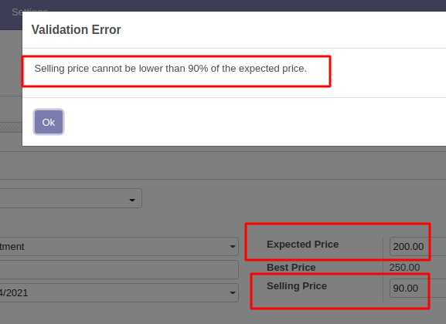
Models
Constraints - Validation
Python constraints
estate/models/property.py
from odoo import api, models, fields
from odoo.exceptions import ValidationError
class PropertyModel(models.Model):
. . .
@api.constrains('selling_price')
def _check_selling_price(self):
for record in self:
if record.selling_price < 0.9 * record.expected_price:
raise ValidationError('Selling price cannot be lower than 90% of the expected price.')

Slide 11
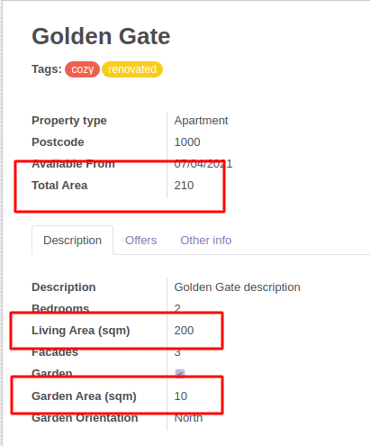
Models
Computed Fields
Dependencies
estate/models/property.py
from odoo import api, models, fields
class PropertyModel(models.Model):
. . .
living_area = fields.Integer()
garden_area = fields.Integer()
total_area = fields.Integer(compute='_compute_total_area')
@api.depends('living_area', 'garden_area')
def _compute_total_area(self):
for record in self:
record.total_area = record.living_area + record.garden_area

Slide 12
Models
Computed Fields
Inverse function
estate/models/property.py
from odoo import api, models, fields
class PropertyModel(models.Model):
. . .
living_area = fields.Integer()
garden_area = fields.Integer()
total_area = fields.Integer(compute='_compute_total_area', inverse='_inverse_total_area')
. . .
def _inverse_total_area(self):
for record in self:
record.garden_area = record.total_area - record.living_area

Slide 13
Models
Onchange
estate/models/property.py
from odoo import api, models, fields
class PropertyModel(models.Model):
. . .
@api.onchange('garden')
def _onchange_garden(self):
if self.garden:
self.garden_area = 10
self.garden_orientation = 'north'
else:
self.garden_area = 0
self.garden_orientation = None

Slide 14
Security - A Brief Introduction
Declare Access Rights
$ cd /home/$USER/src/custom/estate
$ mkdir security
$ touch security/ir.model.access.csv
Những data liên quan tới bảo mật được lưu trong thư mục security
Khai báo permission (CRUD) cho group user
ir.model.access.csv
id,name,model_id/id,group_id/id,perm_read,perm_write,perm_create,perm_unlink
access_test_model,access_test_model,model_test_model,base.group_user,1,0,0,0

Slide 15
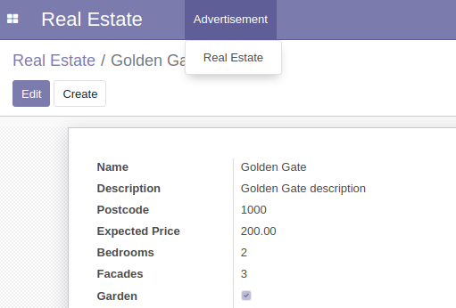
Views
Actions
Actions define the behavior of the system in response to user actions: login, action button, selection of an invoice, …
A basic action for property model
estate/views/estate_property_views.xml
<?xml version="1.0" encoding="utf-8"?>
<odoo>
<data>
<record id="estate_property_action" model="ir.actions.act_window">
<field name="name">Real Estate</field>
<field name="res_model">estate.property</field>
<field name="view_mode">tree,form</field>
</record>
</data>
</odoo>
Basic view mode:
tree: list view
form: detail view

Slide 16
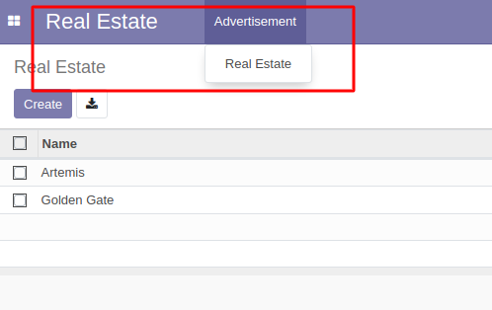
Views
Menus
estate/views/estate_menus.xml
<?xml version="1.0" encoding="utf-8"?>
<odoo>
<menuitem id="estate_dashboard" action="estate_property_action">
<menuitem id="estate_advertisement_menu" name="Advertisement">
<menuitem id="estate_property_menu_action" action="estate_property_action"/>
</menuitem>
</menuitem>
</odoo>

Slide 17
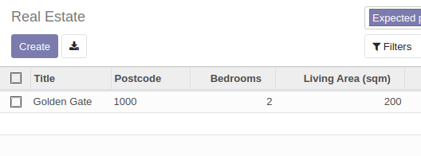
Views
Custom view
Tree - List view
estate/views/estate_property_views.xml
...
<record id="estate_property_list" model="ir.ui.view">
<field name="name">estate.property.list</field>
<field name="model">estate.property</field>
<field name="arch" type="xml">
<tree create="1" delete="1" string="Properties">
<field name="name" string="Title"/>
<field name="postcode"/>
<field name="bedrooms"/>
. . .
</tree>
</field>
</record>
...

Slide 18
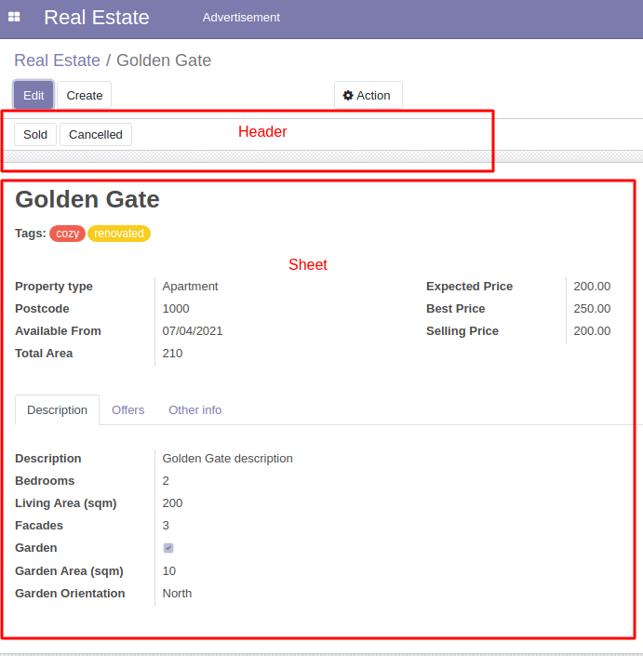
Views
Custom view
Form - Detail view
<record id="estate_property_form" model="ir.ui.view">
<field name="name">estate.property.form</field>
<field name="model">estate.property</field>
<field name="arch" type="xml">
<form string="Property">
<header>
. . .
</header>
<sheet>
. . .
</sheet>
</form>
</field>
</record>

Slide 19
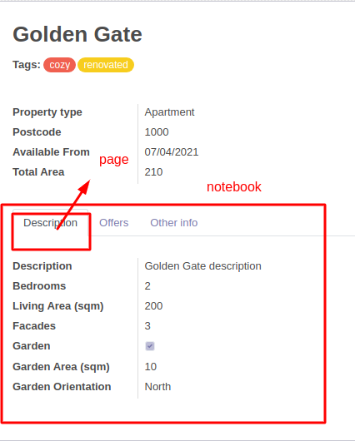
Views
Custom view
Form - Detail view
. . .
<sheet>
. . .
<notebook>
<page string="Description" name="description">
<group>
<field name="description" string="Description"/>
<field name="bedrooms" string="Bedrooms"/>
. . .
</group>
</page>
</notebook>
</sheet>
. . .

Slide 20
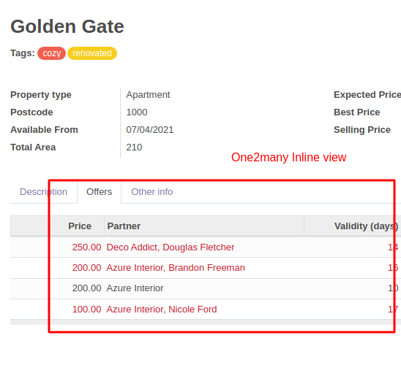
Views
Custom view
Form - Detail view
<notebook>
. . .
<page string="Offers">
<field name="offer_ids" default="{'default_model_id': self}" nolabel="1">
<tree create="1" editable="bottom" decoration-danger="status=='refused'">
<field name="price"/>
. . .
</tree>
</field>
</page>
. . .
</notebook>

Slide 21
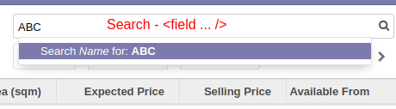
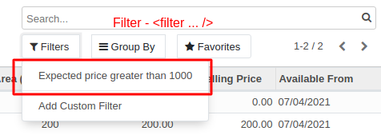
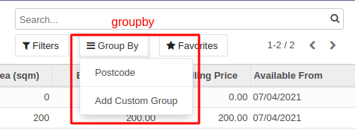
Views
Custom view
Search view
<record id="estate_property_search" model="ir.ui.view">
<field name="name">estate.property.search</field>
<field name="model">estate.property</field>
<field name="arch" type="xml">
<search string="Search property">
<field name="name" filter_domain="[('name','ilike',self)]"/>
<filter name="expected_price_greater_than_1000" domain="[('expected_price','>=',1000)]" string="Expected price greater than 1000"/>
<group expand="0" string="Group By">
<filter name="postcode" domain="" context="{'group_by':'postcode'}"/>
</group>
</search>
</field>
</record>

Slide 22
Views
Custom action
estate/models/property_offer.py
from odoo import api, models, fields
from odoo.exceptions import UserError
class PropertyOfferModel(models.Model):
. . .
def accept_offer(self):
for record in self:
if record.property_id.status != 'open':
raise UserError('Sold or Cancelled property cannot accept offer.')
record.property_id.partner_id = record.partner_id
record.property_id.selling_price = record.price
record.property_id.status = 'sold'
record.status = 'accepted'
Custom action
<button name="<function_name>" string="<display>" type="object"/>
function_name: function gắn với action của model
estate/views/estate_property_views.xml
. . .
<page string="Offers">
<field name="offer_ids" default="{'default_model_id': self}" nolabel="1">
<tree create="1" editable="bottom" decoration-danger="status=='refused'">
. . .
<button name="accept_offer" string="Accept" type="object" icon="fa-check"/>
<button name="refuse_offer" string="Refuse" type="object" icon="fa-times"/>
</tree>
</field>
</page>

Slide 23
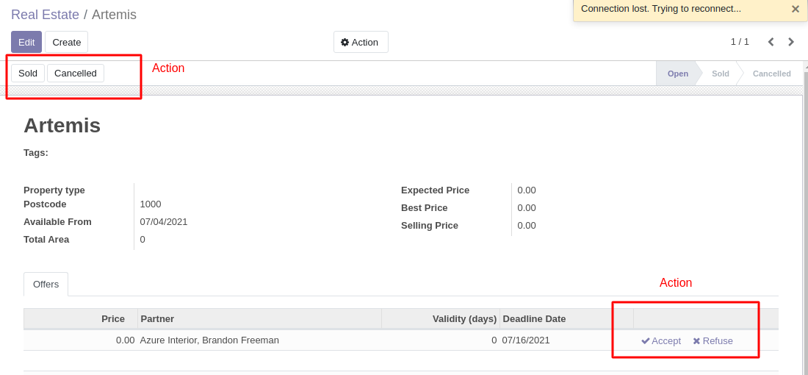
Views

Slide 24
Controllers
Trong trường hợp cần mở rộng thêm các view:
estate/controllers/mycontroller.py
from odoo.http import Controller, route
class MyController(Controller):
@route('/some_url', auth='public')
def handler(self):
return "{'response': 'OK'}"
estate/controllers/__init__.py
from . import mycontroller
estate/__init__.py
from . import controllers
For more detail: https://www.odoo.com/documentation/14.0/developer/reference/addons/http.html
http://localhost:8069/some_url/
=> {'response': 'OK'}

